Slide 1

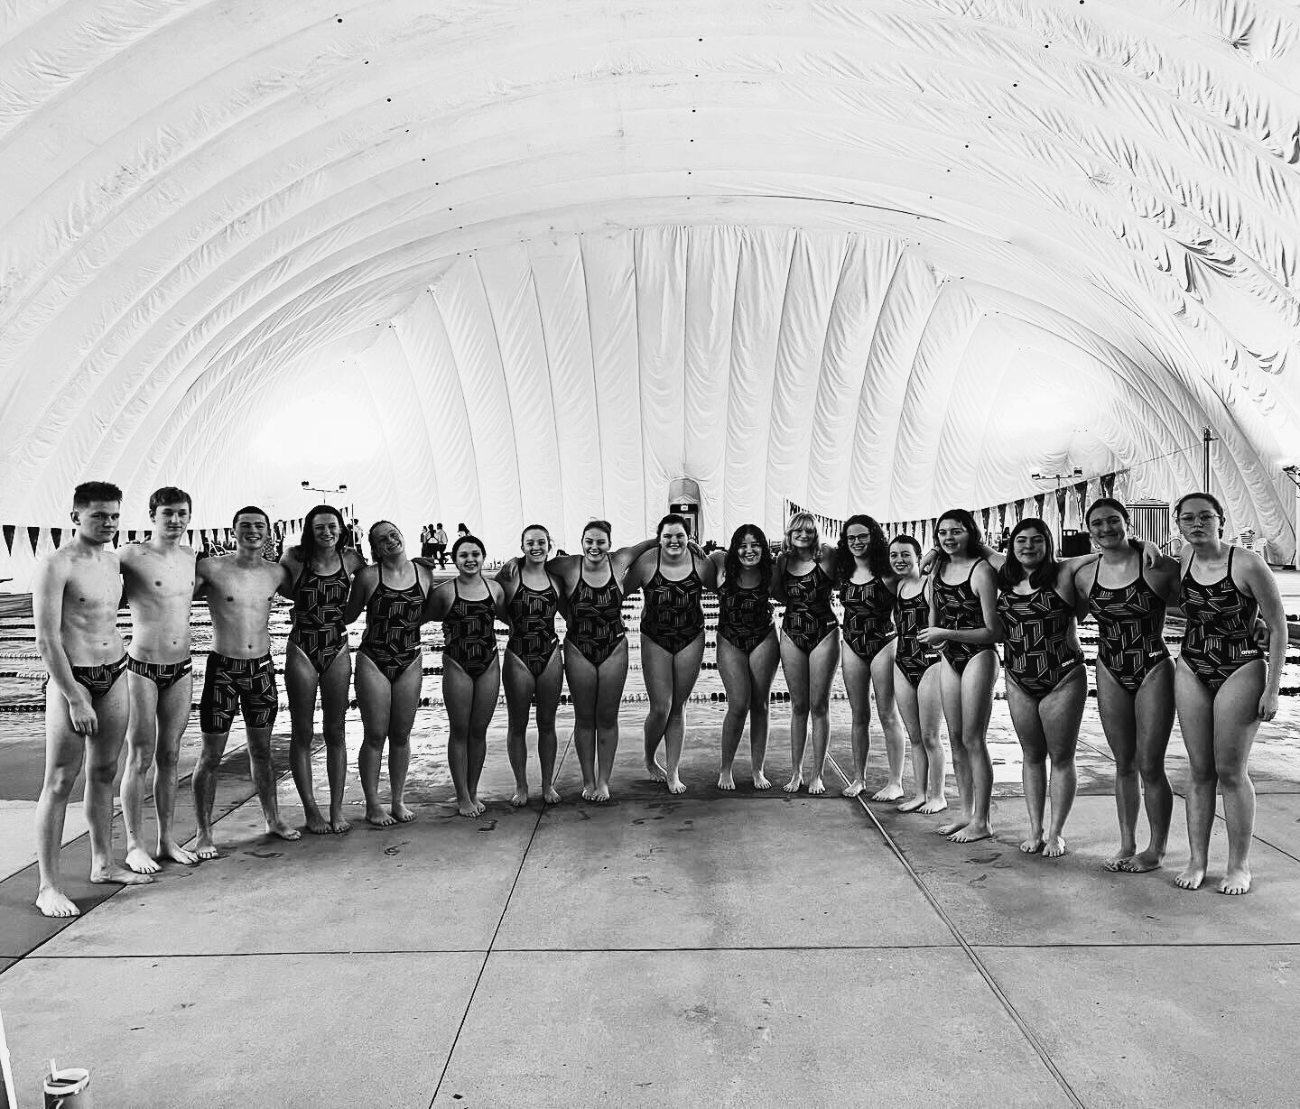
PLYMOUTH PUBLIC SCHOOLS
ATHLETICS
SCHOOL COMMITTEE PRESENTATION
MONDAY, FEBRUARY 12, 2024
SCOTT FRY (PSHS) & JUSTIN DOMINGOS (PNHS)

Slide 2
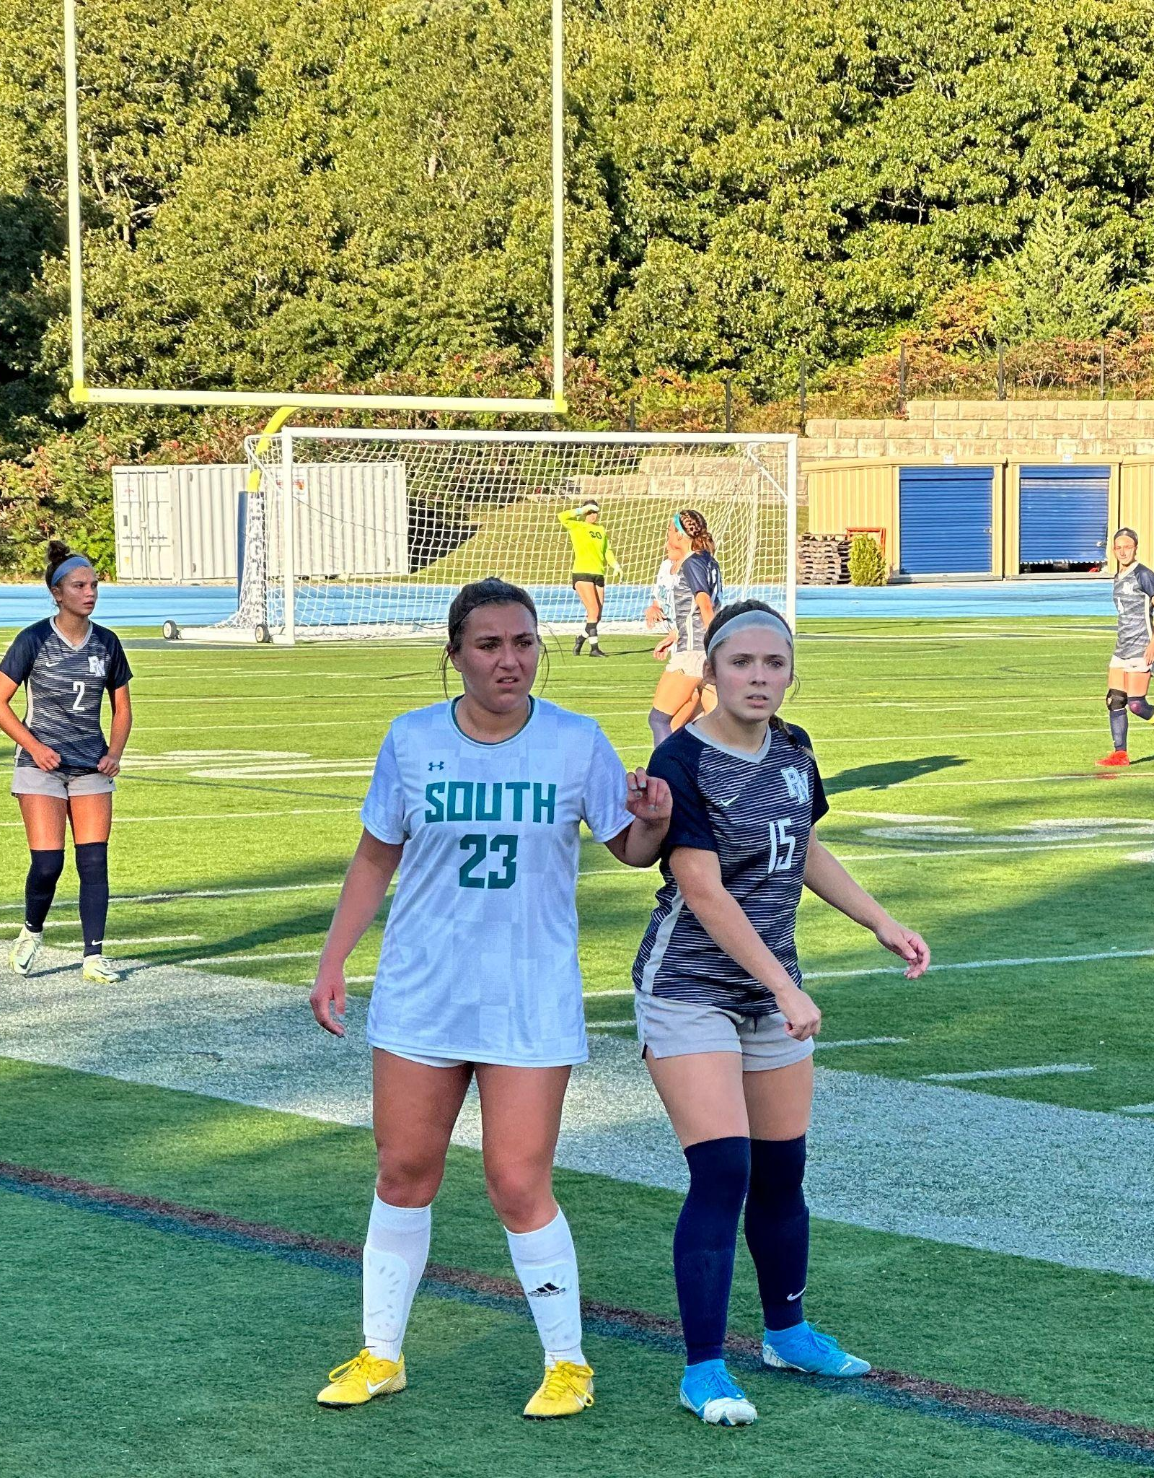
ONE TOWN
Two High Schools

Slide 3
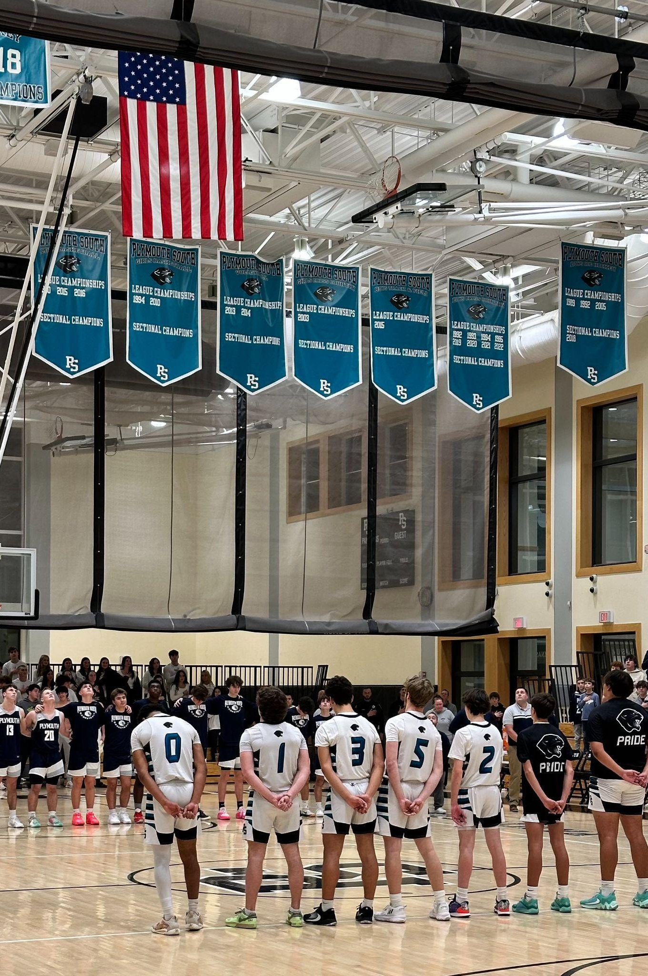
Sports at both high schools:
Fall: Football, B/G Soccer, B/G Cross Country, Field Hockey, Golf, Cheer, & Dance
Winter: B/G Basketball, B/G Hockey, B/G Track, Cheer, Dance, Swim, Gymnastics
Spring: Baseball, Softball, B/G Track, B/G Lacrosse, B/G Tennis

Slide 4
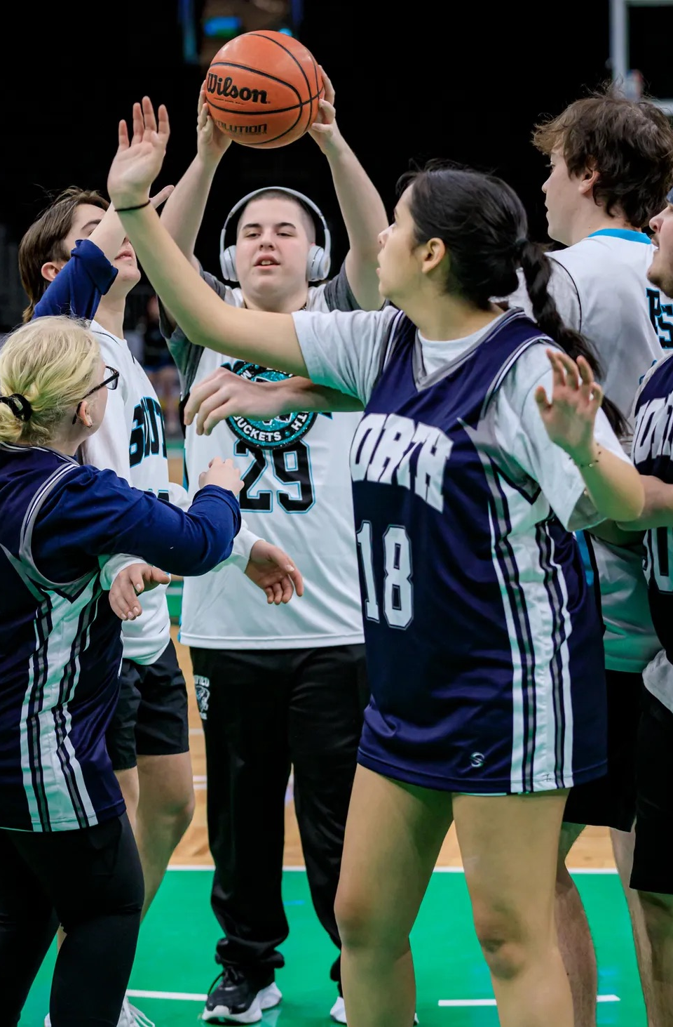
Unified Athletics:
Unified Athletics - Basketball (fall) & Track (spring)
Basketball is a league run sport
PN/PS Unified Basketball Mega Bowl
Weight Training After School
Andrew Lawson Tournament at TD Garden
January 2024

Slide 5
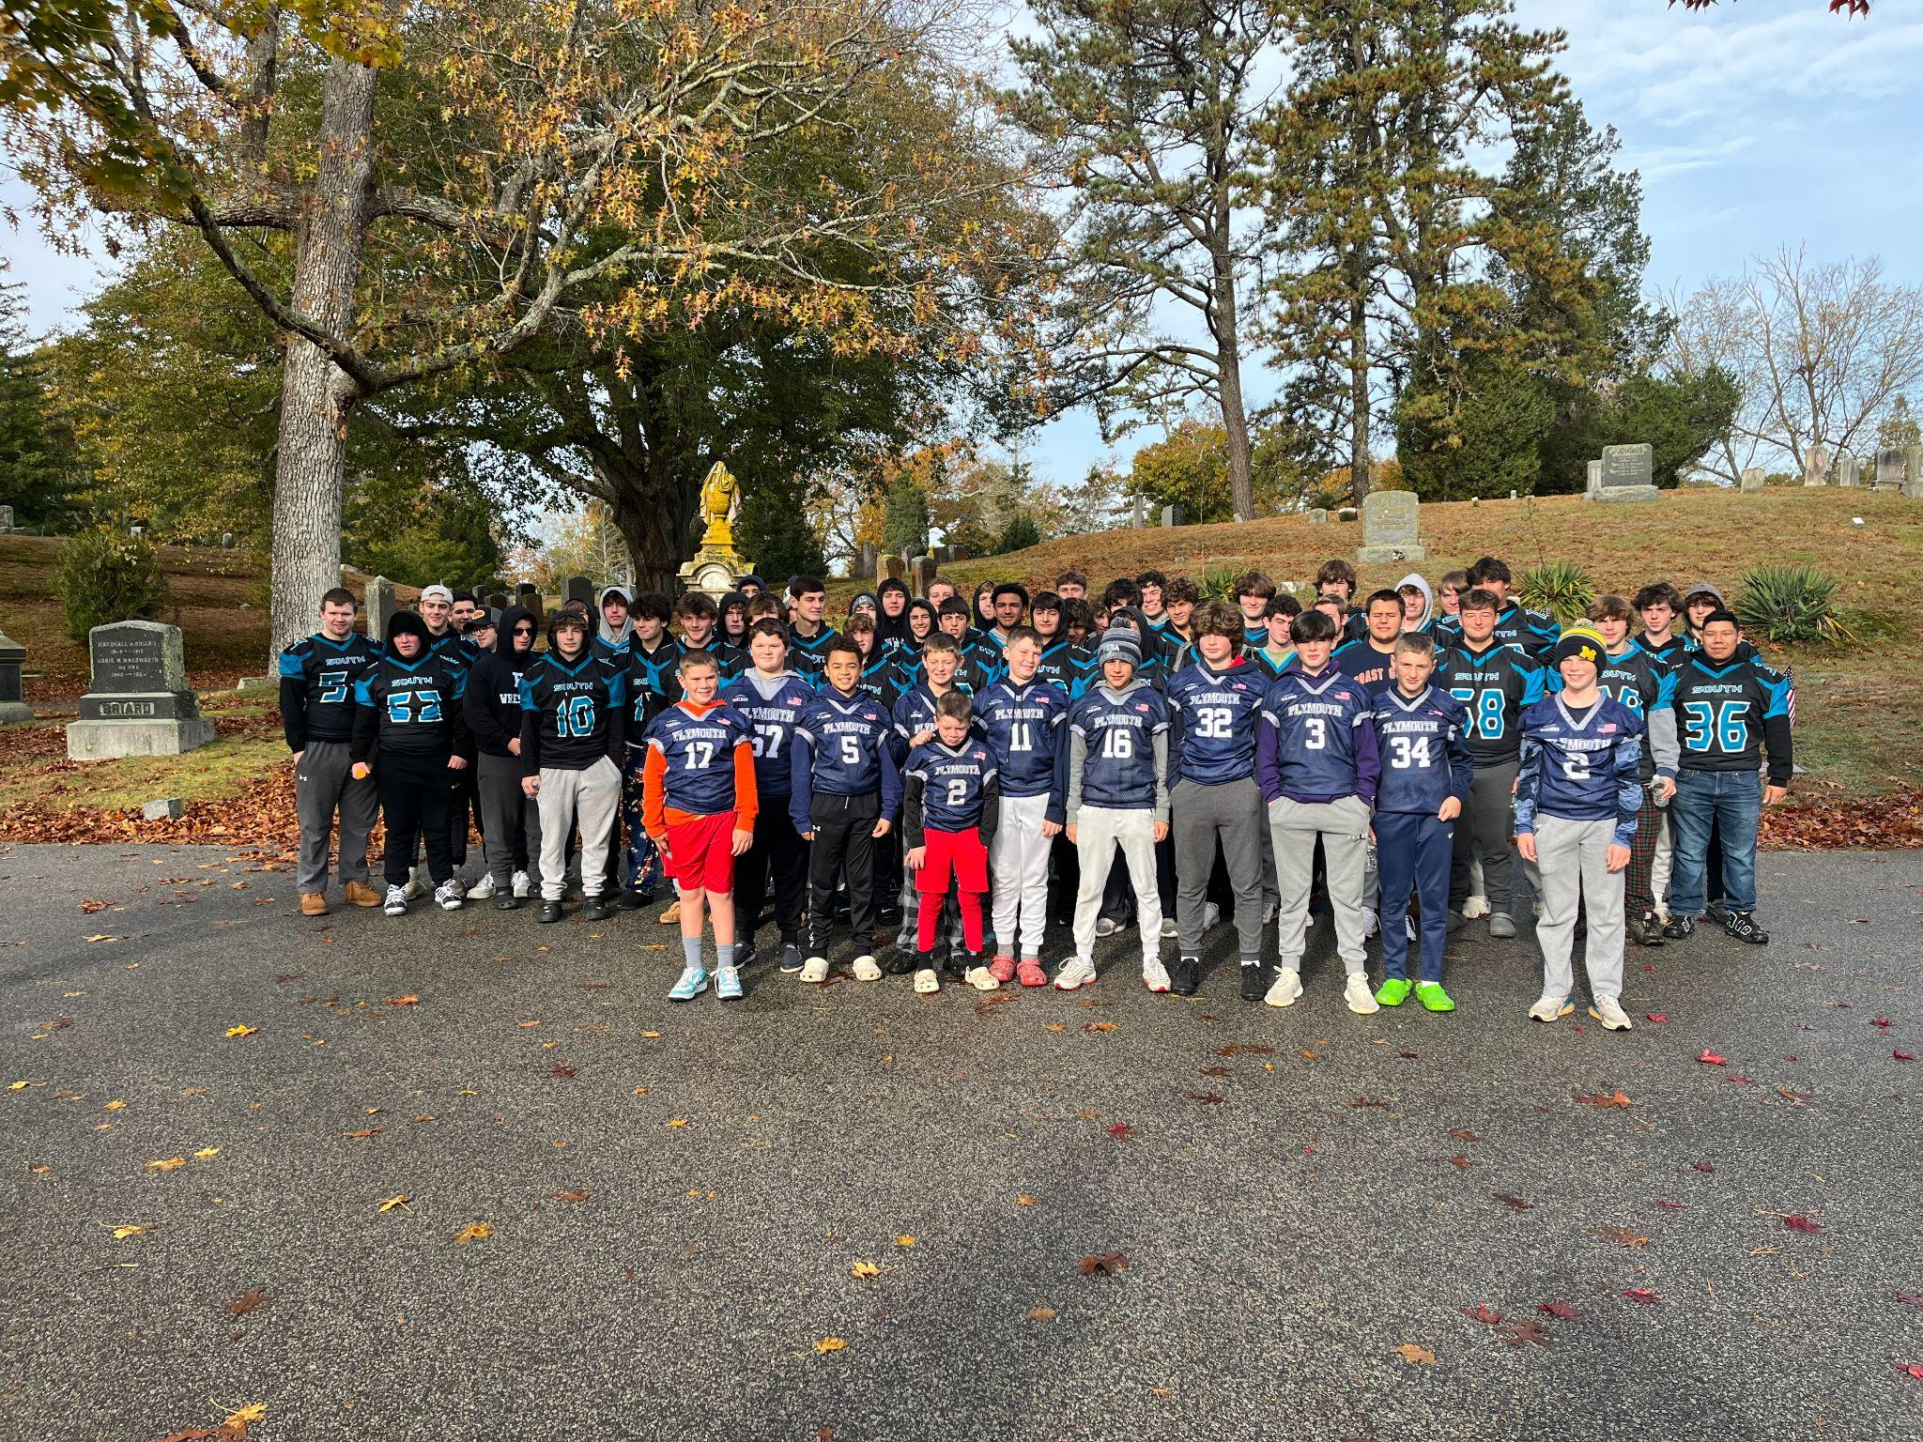
Community Service at PNHS & PSHS:
Requirement for all Teams
Work with local recreation department and community groups
Going Gold & Pink Day Campaigns
Youth Camps & Clinics
Examples:
  Beth-Israel Deaconess Polar Plunge
  Hands and Hearts for the Homeless
  Reading at Local Elementary Schools
  Flags on Veterans Day at Local Cemetary

Slide 6
Facilities at PNHS & PSHS:
State of the Art
Lights let us have availability for all programs on campus
Outside groups - revenue for district
Youth connections
Facility Use Policy
Community Use - track, tennis, etc.
Hosting MIAA state tournament games/meets/etc.
Partner with Town of Plymouth to host recreation dept. Camps (vacation week, summer, etc.)

Slide 7
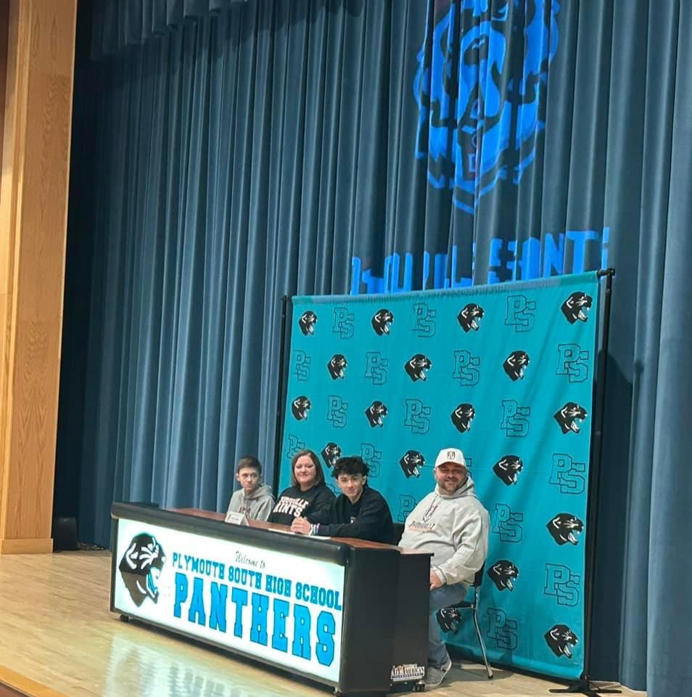
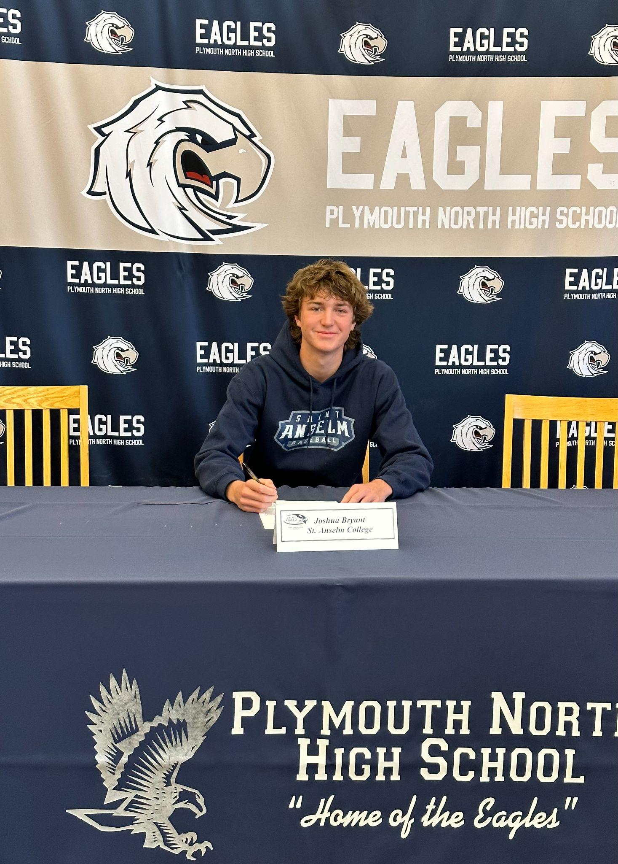
Students participating in college athletics - all time high!
Divisions 1, 2, & 3
NLI Signing Days: Divisions 1 & 2 Scholarships
Culture of playing sports beyond HS exists at both high schools
Focus on NCAA requirements beginning in grade 9 -importance of the transcript

Slide 8
COACHES & Booster clubs:
Key to our successful programs are our coaches
Dedicated both in and out of season
Summer conditioning programs
Communication with teachers regarding student progress
Becoming more difficult to find coaches who can commit to the schedule, time demands, etc.
THANK YOU TO OUR BOOSTER CLUBS!
1 Town 2 Schools Annual Golf Tournament

Slide 9
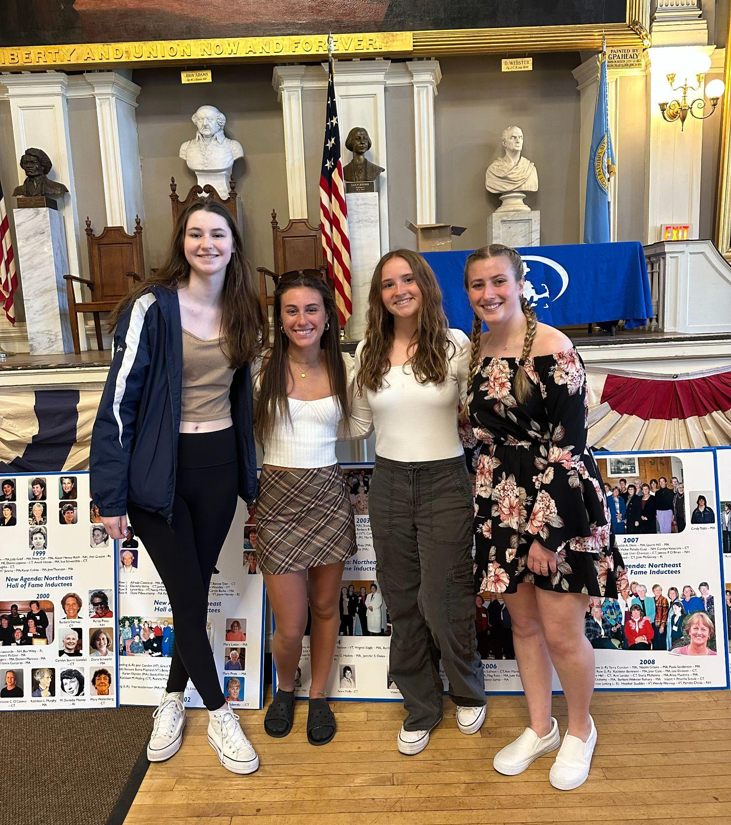
MIAA Connections:
Leadership Workshops - PN & PS Attend Together
Student Ambassadors
South’s Scott Johnson- MIAA Boys Tennis Coach of the Year
MIAA Student of the Month Recognition
Women in Sports Day - Regular Attendees
Hosting of State Events via MIAA
Both North/South AD’s are MIAA Committee Members (South: Football North: Boys Lacrosse, Sports Medicine, District Athletic Chairperson)
Principal Fry- member of MIAA’s ERB & TMC
Principal Parcellin- member of MIAA’s Track committee

Slide 10
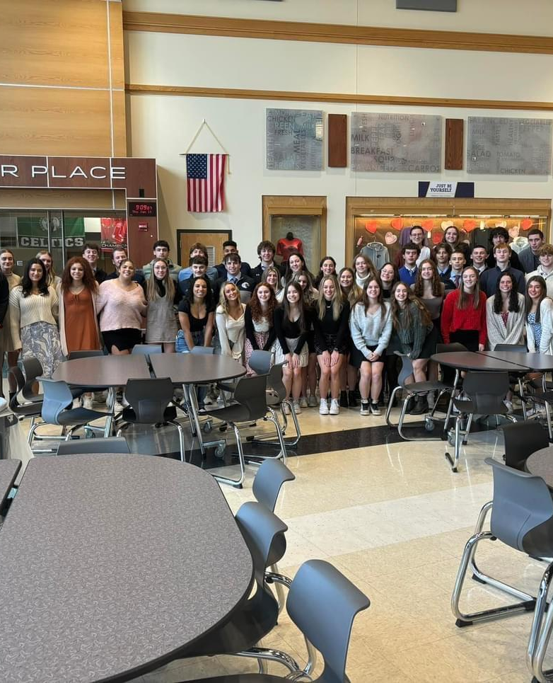
Captain’s Breakfast
Every season (Fall, Winter, Spring) all of sport captains meet for breakfast
Guest speaker
Question & Answer session
Captain’s Passes
Colleen Mersereau

Slide 11
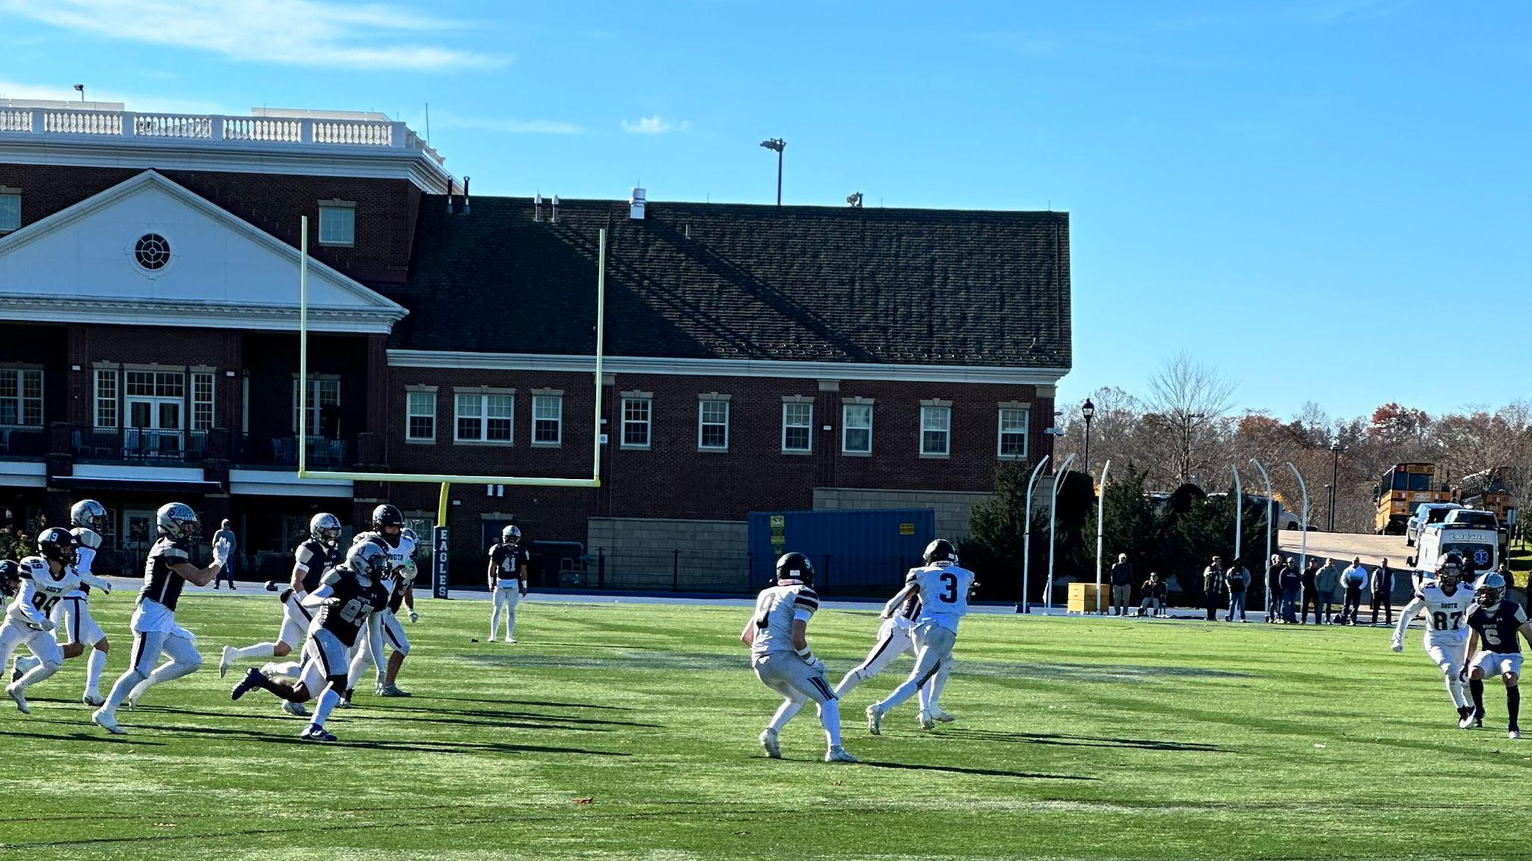
Questions/Comments
Thank you!

